Slide 1
Most Interesting Insights
For Customer Churn Data
(with what to do about them)

Slide 2
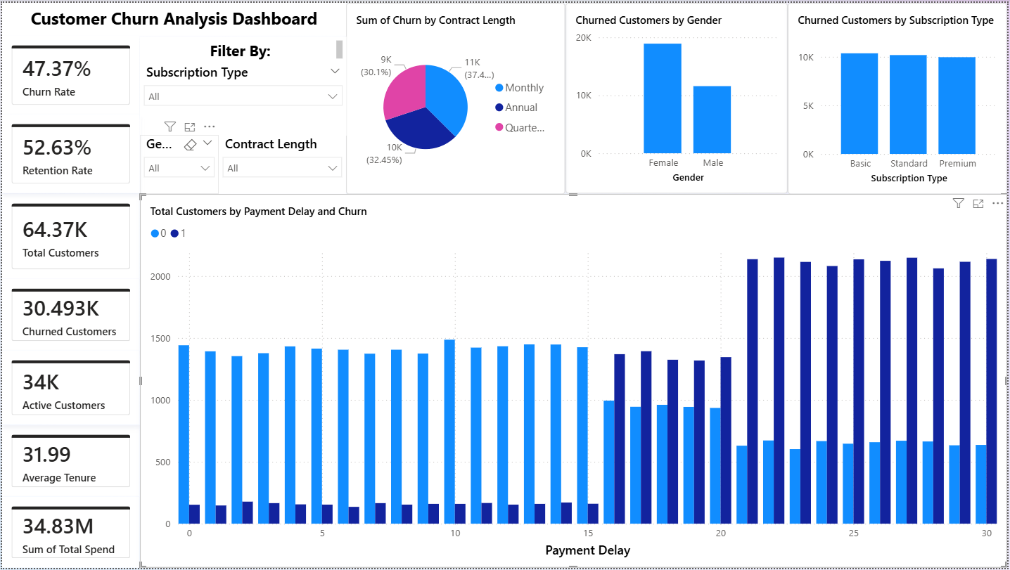
Payment delay is the strongest churn driver.
  Highest correlation with churn: +0.557.
  Customers in the top 25% payment delay (≥25 days) churn at 76.5% vs 37.2% below that—~2.06× risk lift.
  Action: launch a payment health play—SMS/app reminders, auto‑pay nudges, flexible grace periods—whenever delay ≥25 days or velocity of delays rises.

Slide 3
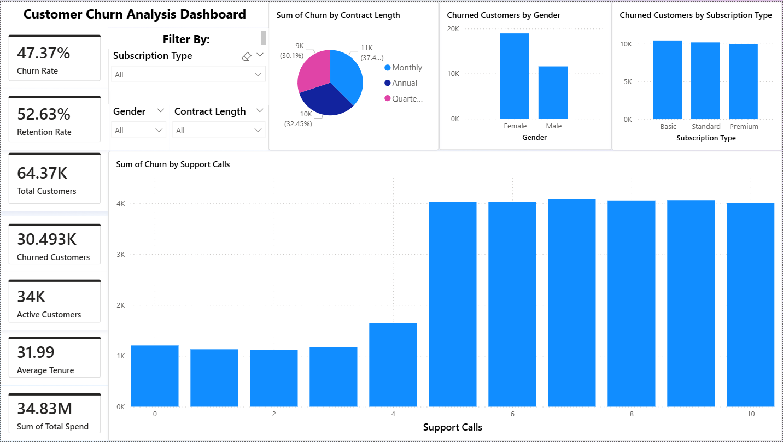
Support friction meaningfully predicts churn.
  Correlation with churn: +0.305.
  ≥5 support calls puts churn at 60.85% vs 41.33% below that—~1.47× lift.
  Action: create a “red flag” queue for customers with 6–8+ calls; route to specialized agents, enable callbacks, and close the loop with in‑app satisfaction checks.

Slide 4
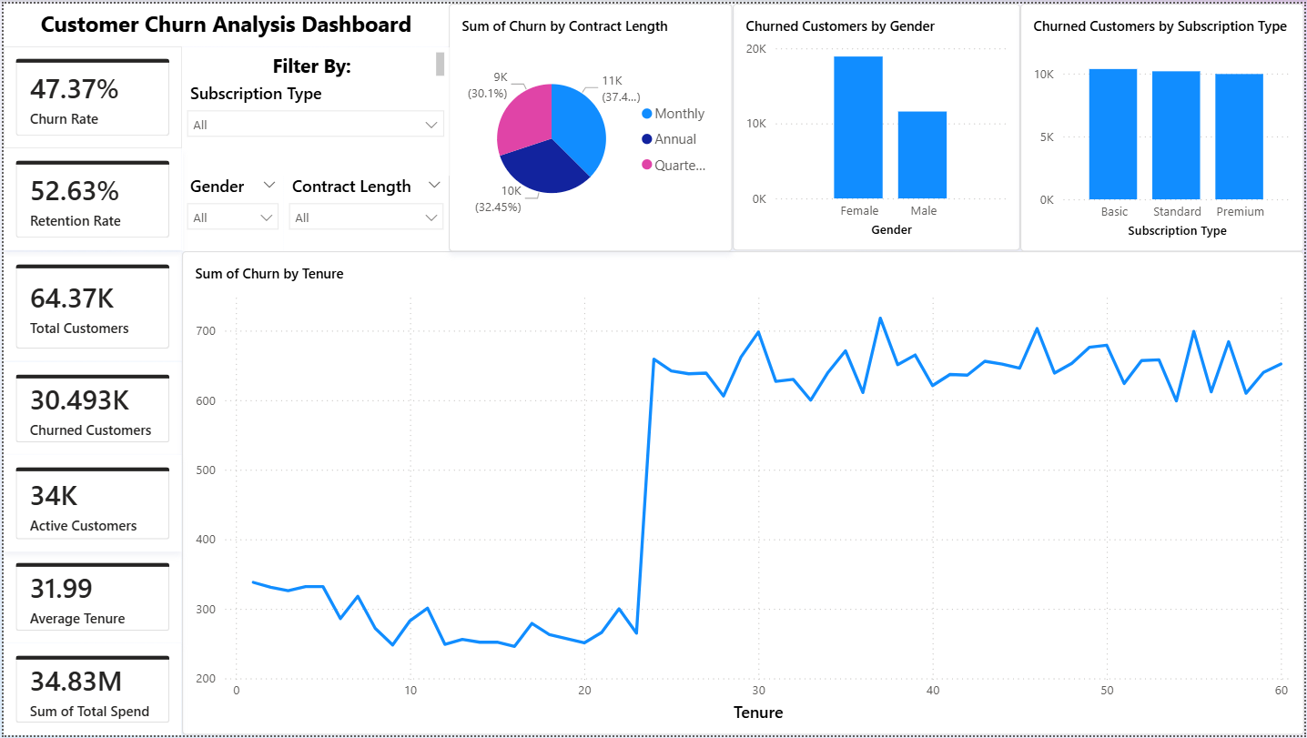
Long tenure is not necessarily safe—watch renewals.
  Churn jumps for 24–36 months (55.79%) and 36+ months (56.02%), much higher than <6 months (34.77%) or 6–12 months (30.11%).
  Action: design renewal‑moment campaigns and “save” offers for customers approaching 24+ months; add proactive outreach 60–90 days pre‑renewal.

Slide 5
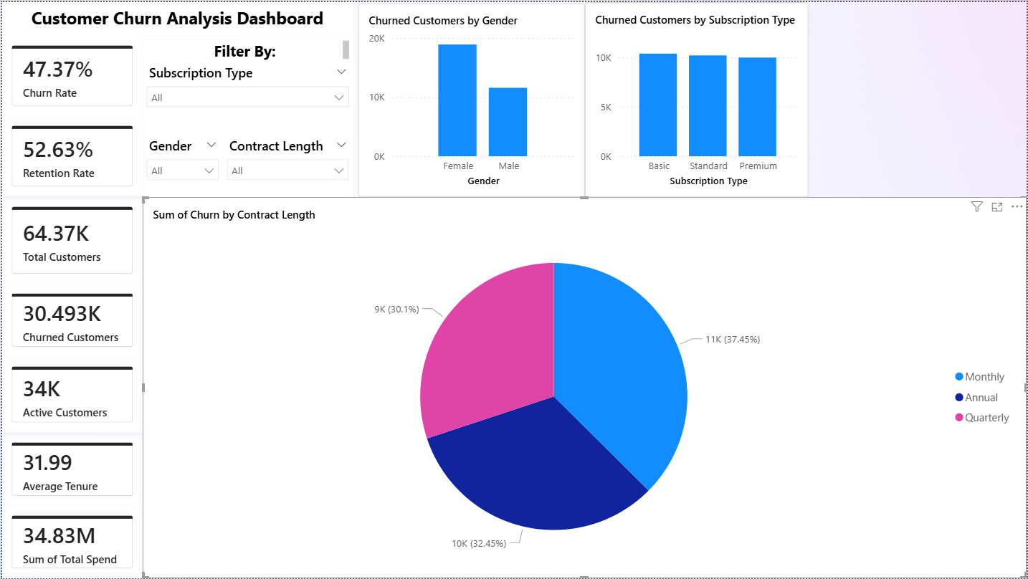
Monthly contracts churn most; quarterly churn least.
  Monthly: 51.61% vs Annual: 46.22% and Quarterly: 44.05%.
  Action: push contract upgrades—e.g., 10–15% discount or added perks for switching to Quarterly; target high‑risk cohorts.

Slide 6
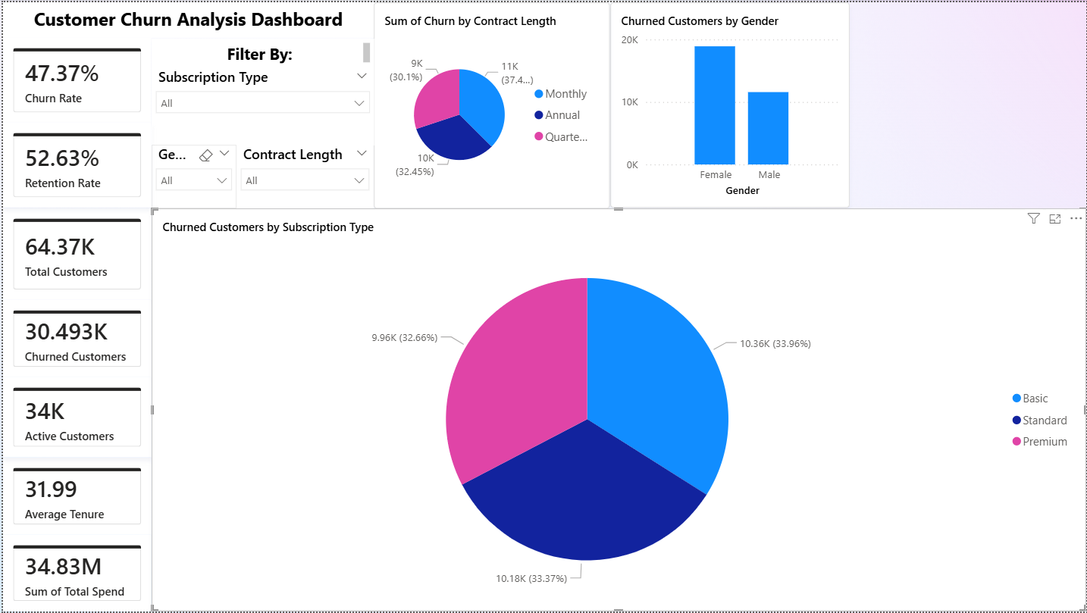
Basic plan has the highest churn; Premium the lowest (but close).
  Basic: 48.28%, Standard: 47.33%, Premium: 46.50%.
  Action: improve Basic value perception (feature education, usage tips) or offer lightweight upgrades; A/B test incentives for at‑risk Basic + Monthly customers.

Slide 7
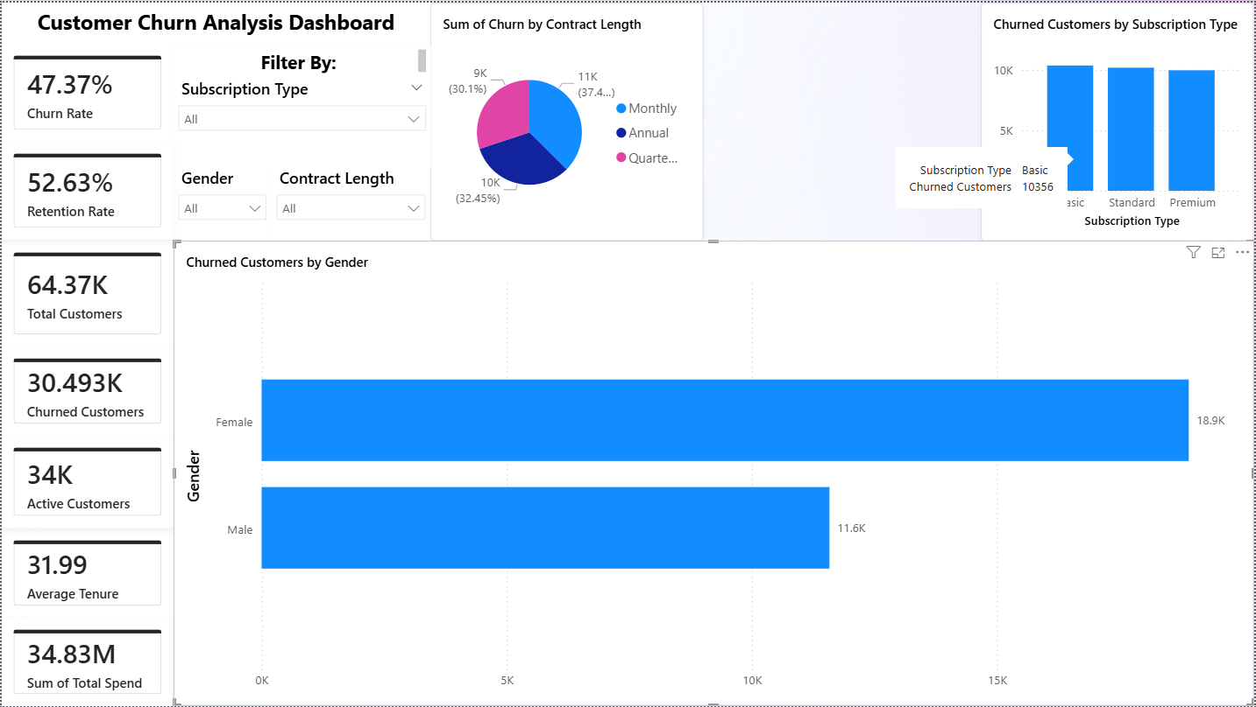
Churn is higher among women in this dataset.
  Female: 55.05% vs Male: 38.58%.
  Action: investigate segment experience (e.g., feature uptake, support paths); ensure interventions are fair, non‑discriminatory, and targeted to behaviors (usage, payment, support) rather than identity.

Slide 8
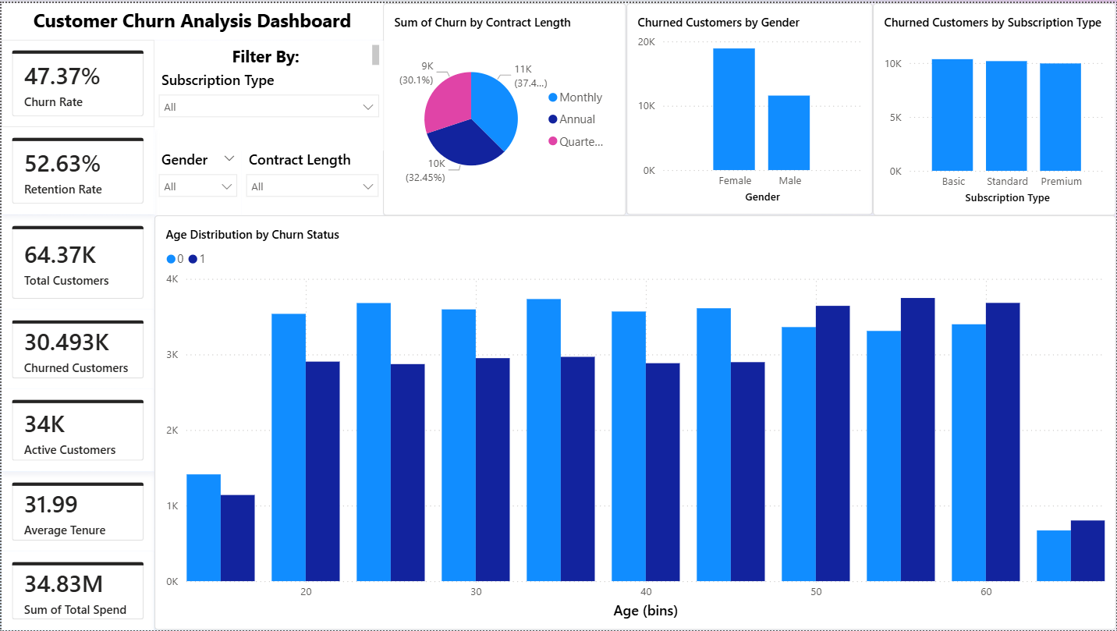
Older age bands churn more.
  50–59: 53.12%, 60+: 52.55%, vs ~44–45% for younger cohorts.
  Action: tailor onboarding/education for 50+ users; simplify flows and proactive help to reduce support escalation.

Slide 9
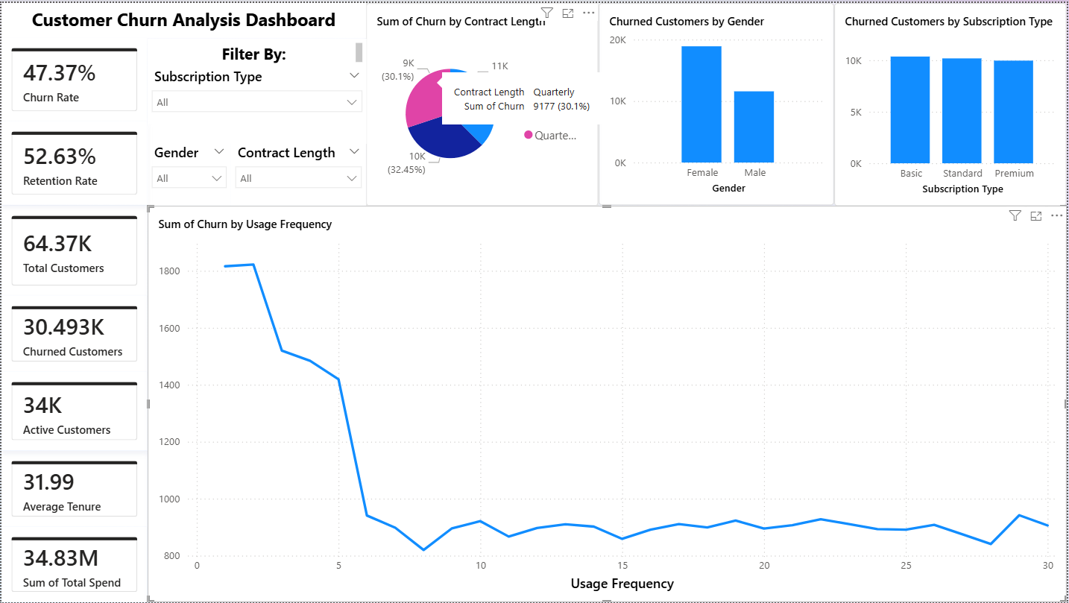
Low usage correlates with churn (as expected).
  Correlation −0.115; churners exhibit lower average usage than non‑churners (usage sits outside top‑5 differences but still negative correlation).
  Action: activation journeys—in‑app tooltips, “next best action” prompts, and weekly usage goals; trigger when usage drops below the 25th percentile.

Slide 10
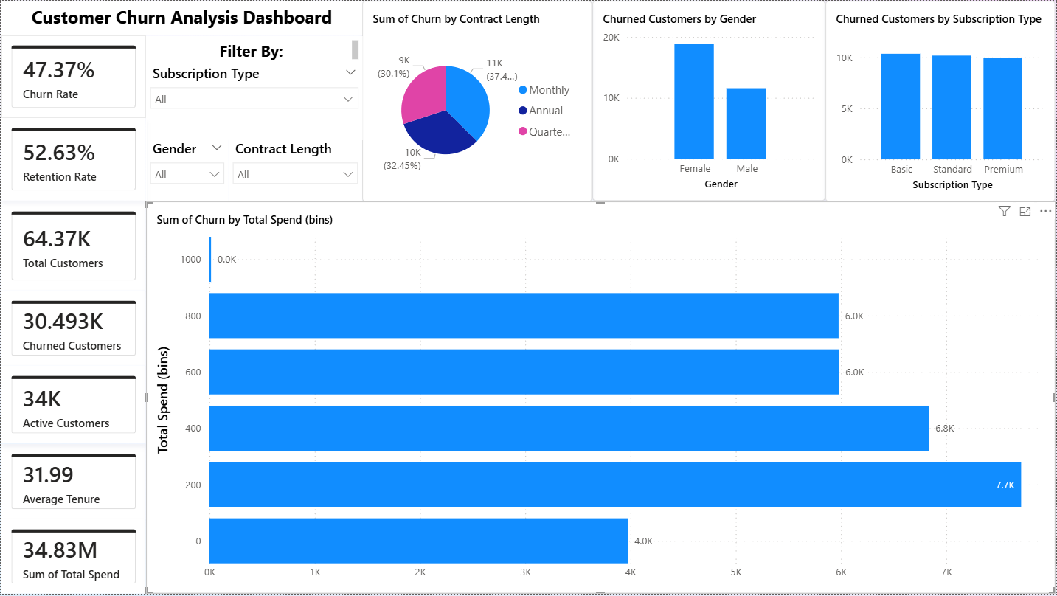
High spenders churn less (but it’s not zero).
  Q4 (High spend): 43.14% vs Q1 (Low): 52.51%.
  Action: protect revenue at risk—watch high‑spend users with rising delays/support calls and offer VIP outreach and renewal bonuses.

Slide 11
Actionable strategies for Improving retention rate
1. Analyze Churn Drivers
  Use your data to identify patterns: Are churned customers concentrated in certain subscription types, contract lengths, or age groups?
  Segment customers by risk factors (e.g., high support calls, payment delays).
2. Improve Customer Experience
  Proactive Support: Reduce support call frequency by offering self-service tools and faster resolution.
  Personalization: Tailor offers and communication based on usage frequency and preferences.
3. Incentivize Long-Term Commitment
  Offer discounts or perks for annual contracts instead of monthly.
  Introduce loyalty programs for long-tenure customers.

Slide 12
Actionable strategies for Improving retention rate
4. Address Payment Issues
  Implement reminders and flexible payment options to reduce payment delays.
  Offer grace periods or auto-pay features.
5. Monitor Engagement
  Track usage frequency and intervene early when activity drops.
  Send personalized nudges or educational content to increase product adoption.
6. Predict and Prevent Churn
  Build a predictive model using your dataset to flag high-risk customers.
  Deploy retention campaigns (discounts, personalized outreach) for those flagged.

